Slide 1
Energy in a vibrating string
The total energy of each normal mode is composed of kinetic and potential energy.
The kinetic energy density is defined as the kinetic energy per unit length or
where ρ = linear density

Slide 2
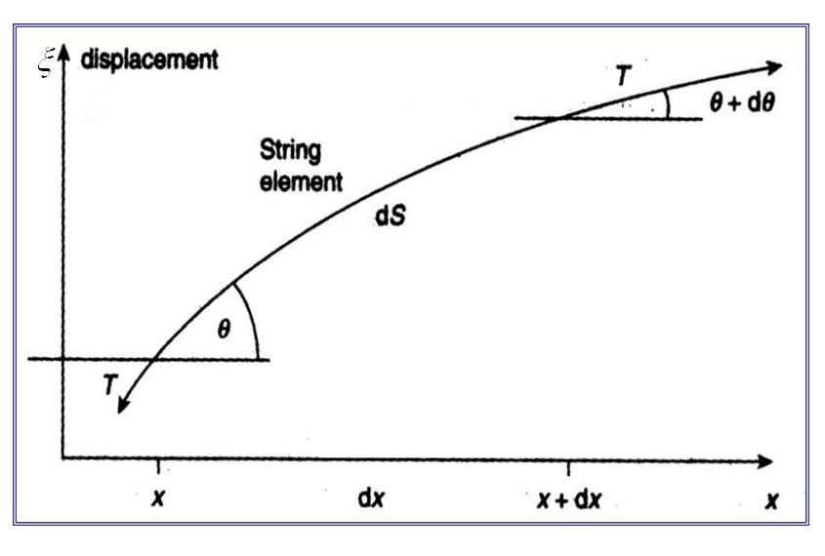
Now consider the potential energy density.
Recall the vertical motion of the string element, the tension is given by
Since θ is very small, sin θ ≈ tan θ = ∂y/∂x so that the vertical resultant force is given by
The resultant force causes a differential change in the length of the string element.
The work done on the string element by the tension is actually the potential energy.
This potential energy is called “differential elastic potential energy.”
http://jennarocca.com/equation-of-a-transverse-wave-on-string/

Slide 3
The differential change of the string element may be given as
The differential elastic potential energy is a consequence of the stretched string element by tension T and given by
Therefore, the potential energy per unit length is

Slide 4
Example : Total energy of the string element
Determine the kinetic energy of the string element in a wavelength
Determine the elastic potential energy of the string element in a wavelength
Determine the total energy of the string element in a wavelength
Given that the wave function of a travelling wave :

Slide 5
Kinetic energy in a wavelength
Elastic potential energy in a wavelength
The total energy of the string element in a wavelength
The magnitude of an average power required to vibrate a string whose length is one wavelength is given as
Notes:
uλ =(1/4)Tk^2A^2λ
Eλ =(1/2)μω^2A^2λ

Slide 6
Energy in each normal mode of a vibrating string with both ends fixed
Kinetic energy in the nth harmonic Potential energy in the nth harmonic
By using the expression for the standing wave
The total kinetic energy of the nth harmonic standing wave

Slide 7
How to obtain the expression of the standing wave
Let’s begin with wave equation :
Assume that the solution of the wave equation is given as
By using the technique of separation of variables, two differential equations depending on x and t are obtained.
Where k = separation constant and, in this case, the wave number

Slide 8
Both differential equations can be simply solved and the solution are found to be
This leads to the general solution for the wave equation as follows
To obtain the standing wave solution, appropriate boundary conditions have to be applied.

Slide 9
As the system under interest is a string fixed at both ends (x = 0 and x =l)
Appropriate boundary conditions at all times for the standing wave are given as
This leads to a particular solution satisfying the boundary conditions and the solution can be expressed as
.
Therefore, the standing wave for nth normal mode can be written as
Notes:
At y(x=l,t) = 0, kx has to be nπ. This leads to k = nπ/l

